Slide 1
MATLAB for image processing Session 2: Matrices and image processing

Slide 2

Course structure
Session 1
Introduction to MATLAB
Data types
Conditional statements and loops
Session 3
Advanced data structures
Advanced image reading (Bioformats)
Object-oriented programming
Session 2
Data input/output
Matrix operations
Figures and plotting
Image processing
Session 4
Designing a user interface
Requests? Let me know!
stephen.cross@bristol.ac.uk

Slide 3
Data input/output
Is this necessary?
It’s just another function…
Notes:
Convert this into 2 spider diagrams if there’s time

Slide 4
Reading data from file
Examples
csvread
xlsread
Imread (say we will cover this in more detail later)
Is this necessary?
It’s just another function…

Slide 5
Saving data to file
Examples
xlswrite
Imwrite (say we will cover this in more detail later)
Is this necessary?
It’s just another function…

Slide 6
Matrix operations
Notes:
Convert this into 2 spider diagrams if there’s time

Slide 7
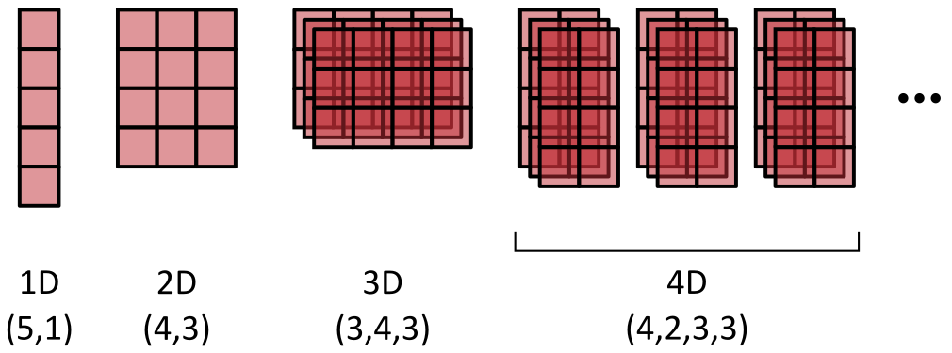
Introduction to matrices
So far we’ve only looked at variables holding a single value
Matrices hold multiple numeric values in an n-dimensional grid
MATLAB is specifically optimised for calculations on these
Have a minimum of 2 dimensions (XY)
XY dimensions always specified first in the order (row, column)

Slide 8
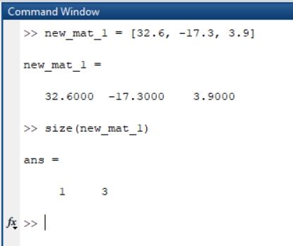
Creating matrices
Create a matrix from known values
Comma-separate items on the same row
Semicolon-separate rows
A single row matrix
new_mat_1 = [32,-12,7];
A single column matrix
new_mat_2 = [1;2;3];

Slide 9
Creating matrices
Initialising an empty matrix
Matrices can be re-sized, but this is SLOW

Slide 10
Creating matrices
[Have them do an exercise]

Slide 11
Accessing matrix data
Access values in a matrix using coordinates

Slide 12
Introduction to matrices
Demo creating a small matrix
Could use rand(3)
Dimension order
Indexing
Accessing a single value
Accessing a range of values

Slide 13
Introduction to matrices
Matrix operations
Start by adding a single value to a matrix
Add two matrices together
Talk about the element-wise dot (e.g. .*)

Slide 14
Initialising matrices
Why and how?
Demo of creating a matrix
Non-initialised
Initialised

Slide 15
Optimising code
Tic toc
Demo
Profiler
Demo

Slide 16
Visualising data
Notes:
Convert this into 2 spider diagrams if there’s time

Slide 17
Image loading
Figures and plotting
Generate a 1D trace, then plot this
Functions
hold
gca

Slide 18
Image processing
Notes:
Convert this into 2 spider diagrams if there’s time

Slide 19
Image loading
Using standard libraries
imread
Oh look, they’re matrices
Multidimensionality

Slide 20
Visualising images
image
imagesc
imshow

Slide 21
Image processing
Filters
Median
Gaussian
Thresholding
Otsu method

Slide 22
Saving images
imwrite

